Slide 1


Towards a better mobile web for airlines
Jean Mouyade
Digital innovation
Amadeus Digital Forum 2020
Notes:
Hello, I am Jean Mouyade working in Digital R&D and I going to talk about the mobile web and how to make it better

Slide 2
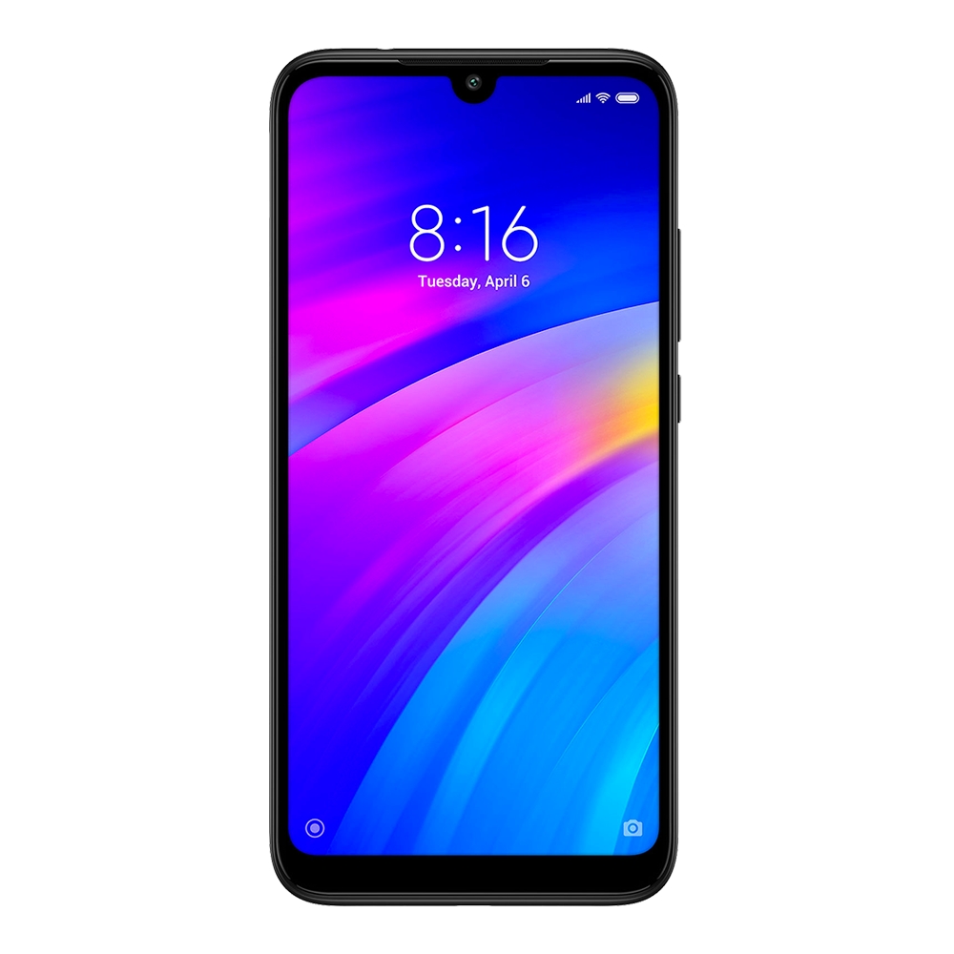
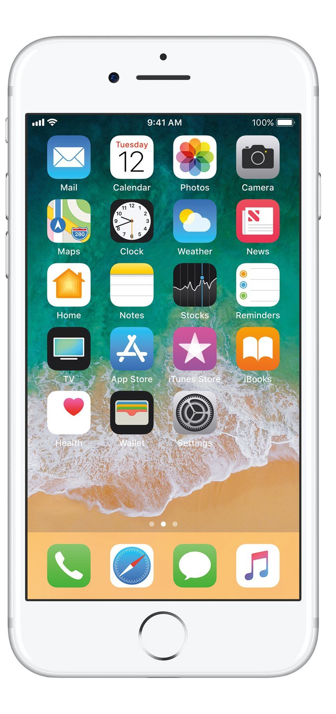
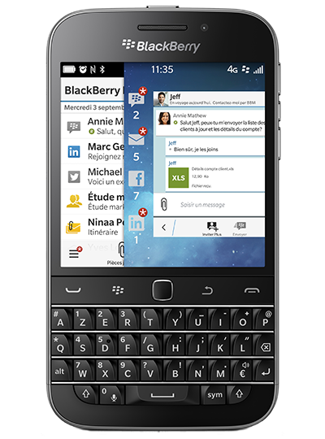
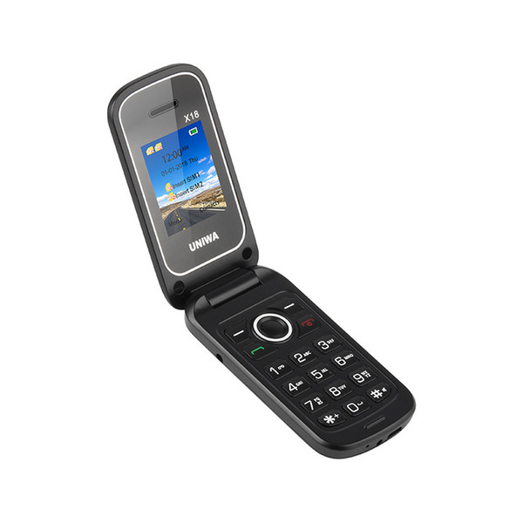
Smartphone anyone ?
Notes:
How many smartphones in this room ?
We are approximately 200 and there are at least 200 smartphones
According to statistics, 2 of you have a smartphone like this one and I feel sorry for you
But a vast majority have a device like this one, iPhone or Android

Slide 3





The problem
Is it worth installing the app ?
Notes:
And when customers want to access airline services, they are given the choice between the web and the app.
And they are going to go one way or the other depending on criteria

Slide 4

Speed
Notes:
The most obvious one is speed
Let’s compare web speed vs app speed

Slide 5
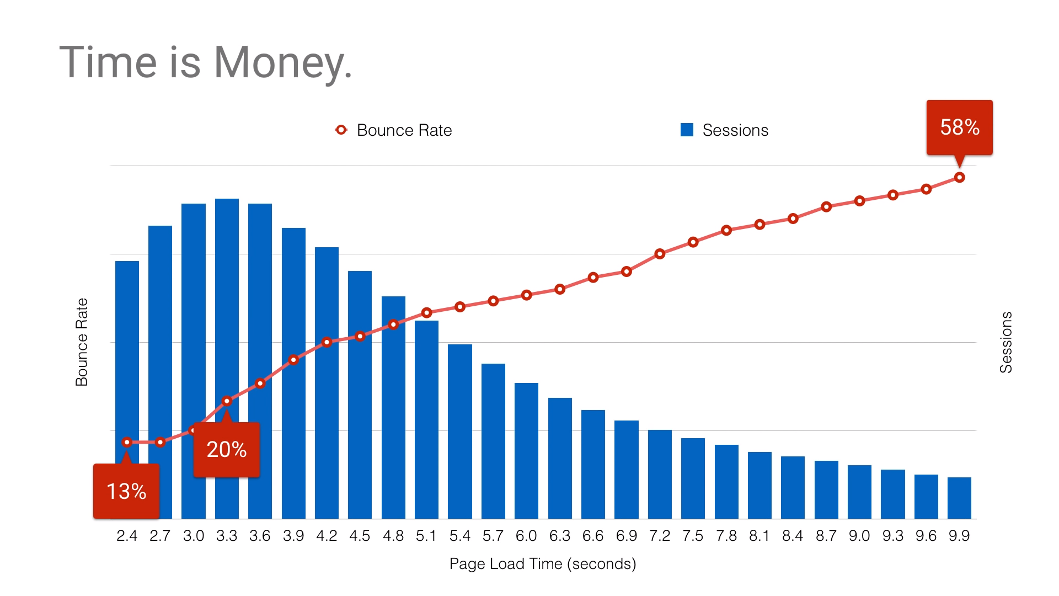
Notes:
This graph shows the relation between the response time and the drop rate
For example, you can determine that after 10 seconds, you have lost 58% of customers because they consider you application is too slow
The web takes approximately 6 to 7 seconds to load where app is between 2 and 3 seconds
The obvious winner is the app

Slide 6
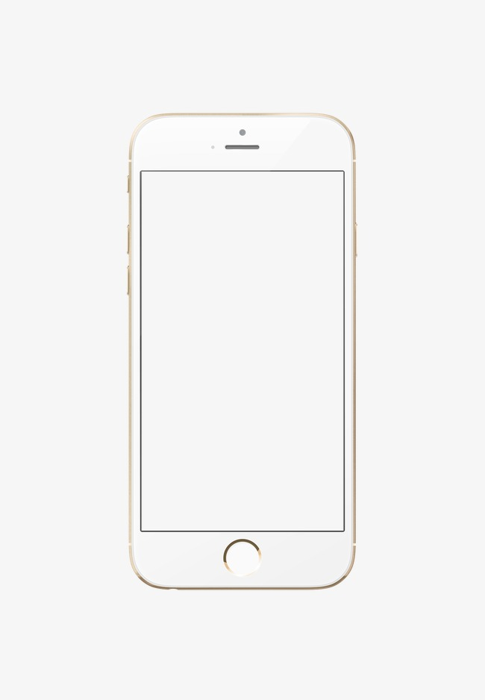
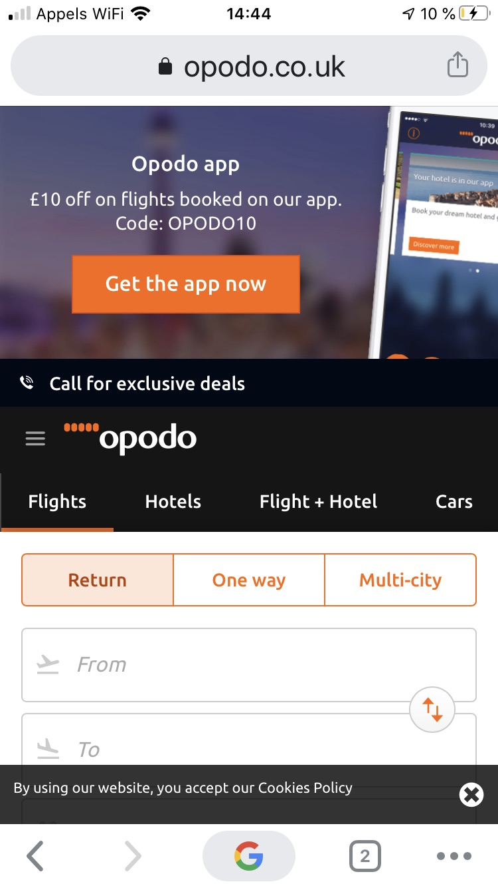
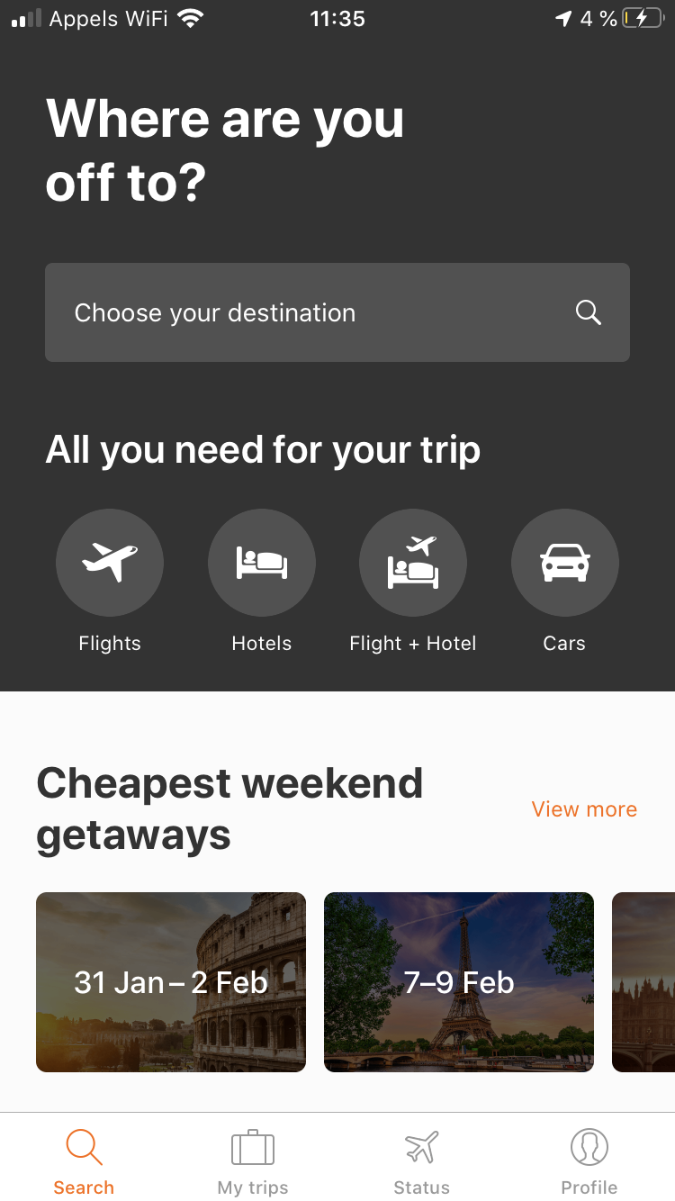
URL bar
App teaser
Usable space
Cookie consent
Navigation bar
Notes:
In terms of usability, when I open the web page of opodo for example
You can see on top the URL bar, very useful at the beginning the useless afterwards
Then an annoying prompt to install the app
And at the bottom, the cookie consent then the URL bar
Which leaves us with far less usable space than the app on the right

Slide 7
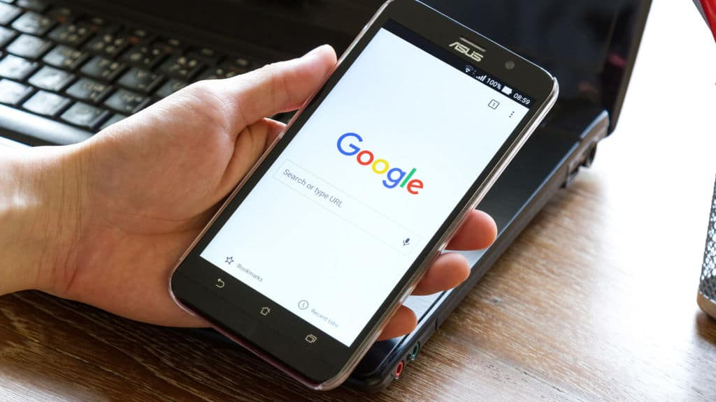
Search
content
Notes:
Search : the web content is indexed by search engine, the app is not.
Clear winner : the web

Slide 8
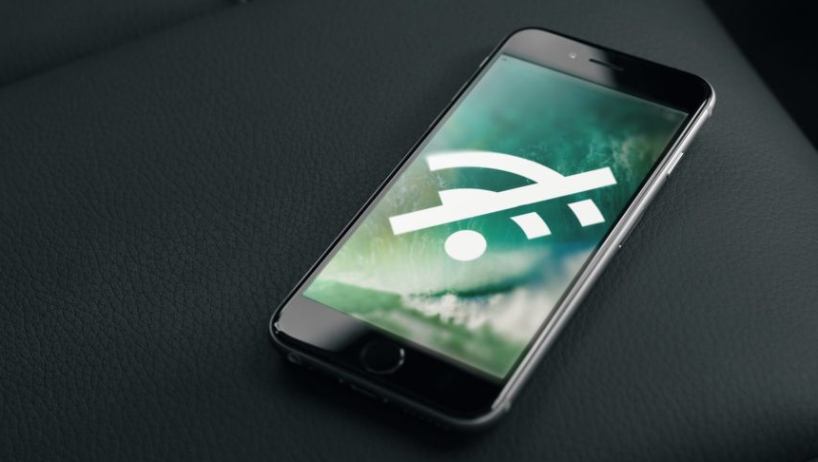
No connectivity
Notes:
When you are offline or have poor connectivity, the app can provide a fallback mode, the web cannot
One more point for the app

Slide 9
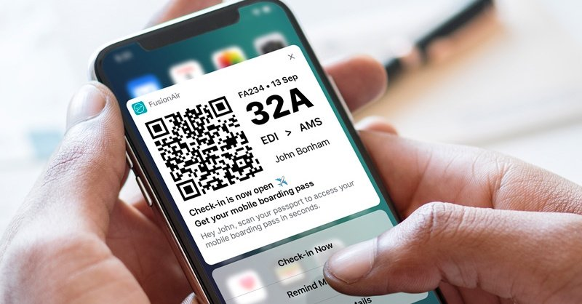
Push notifications
Notes:
Push notifications are very popular on apps and few people know that there are push notifications on the web
Therefore the winner is once again the app

Slide 10
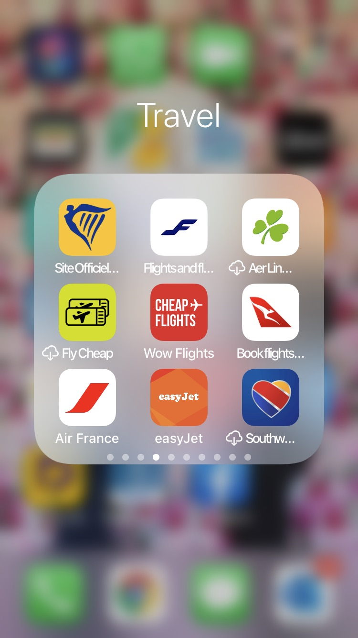
Updates
Smartphone
memory
Notes:
Here’s a screen capture of my phone.
This little icon means that you think you have the app but you don’t, you have to download it to use it.
An airline app is between 50 and 200 Mb which is way more than the web
Here the winner is the web

Slide 11

Notes:
Finally cost : you have to deliver a mobile web and for the app, you need a iOS dev team, an Android dev team. You need to have your app approved by Apple and Google.
Winner : The web

Slide 12
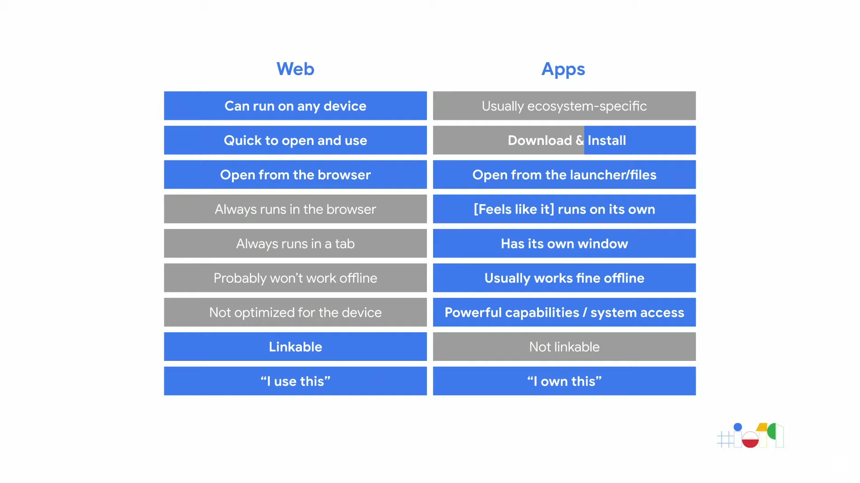
Progressive Web Application to the rescue
Notes:
So if we summarize, the Web is universal, provides a quick access and is cheap but the usability is not that great compared to apps which are fast and usable.
But apps require an install and I quite costly.

Slide 13

Progressive Web Application to the rescue
Progressive Web Apps are web sites that provide a native app experience
Notes:
Couple of years ago, Google came up with a new concept call PWA.
PWA stands for Progressive Web App
PWA is a web application that behave like a native application

Slide 14
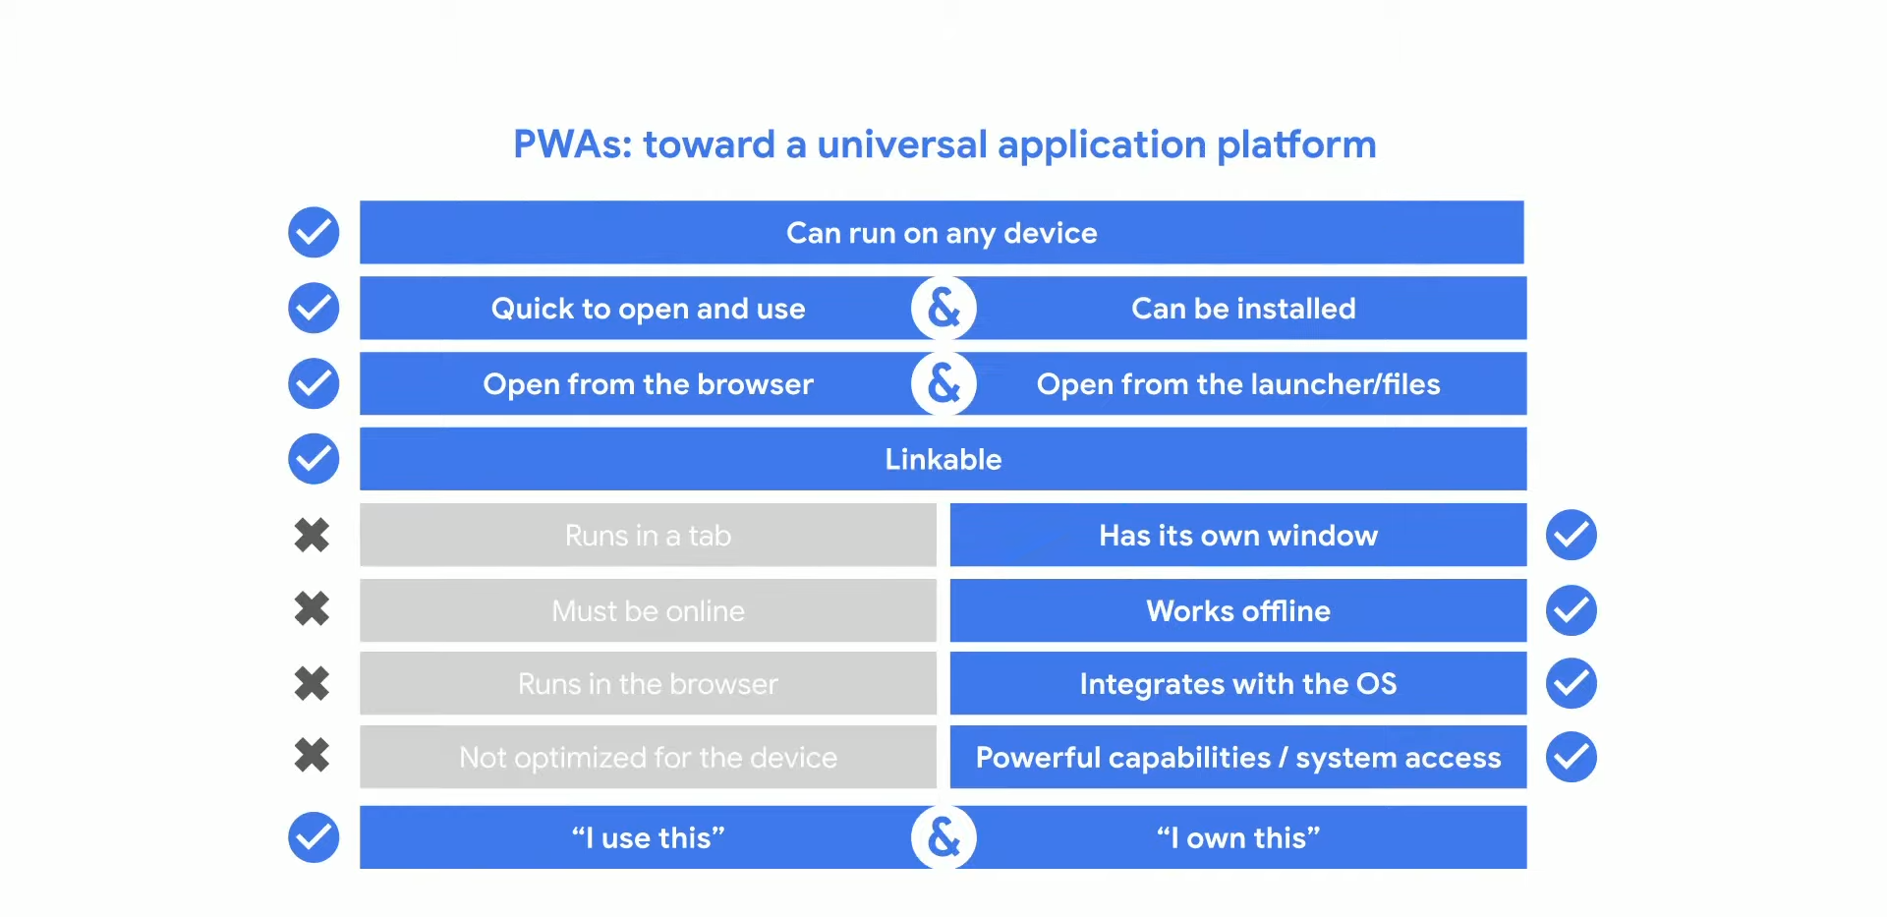
Progressive Web Application to the rescue
Progressive Web App : best of both worlds
Notes:
When they defined PWA they took the best of both platforms

Slide 15
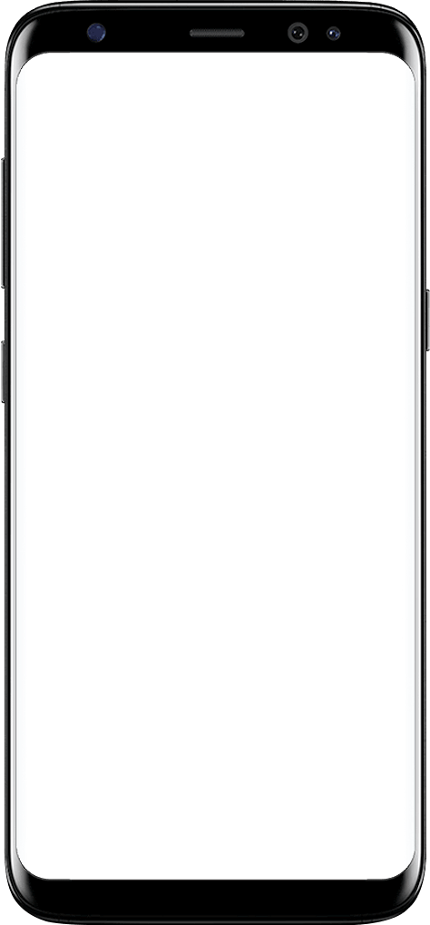
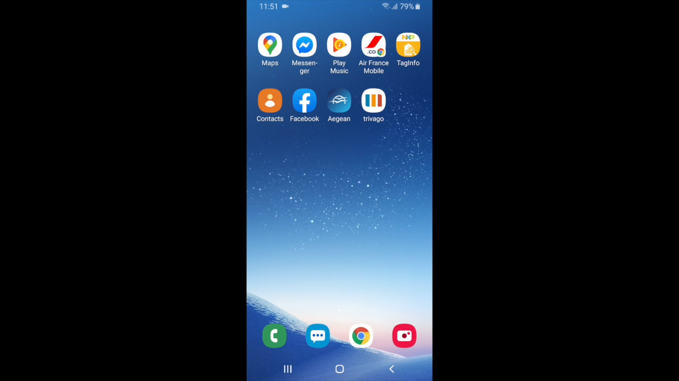

Install process
Quick access
Custom install prompt
Notes:
Let me demo how a PWA could be :
Our app is Horizon airways. Let me create a booking using the mobile web

Slide 16
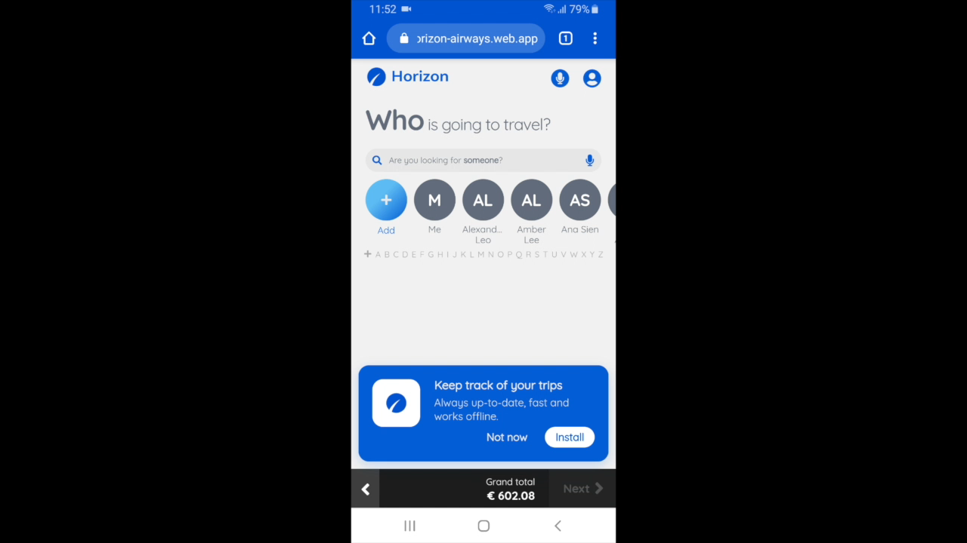
Install process
Quick access
Custom install prompt
Background and fast install
App icon

Slide 17
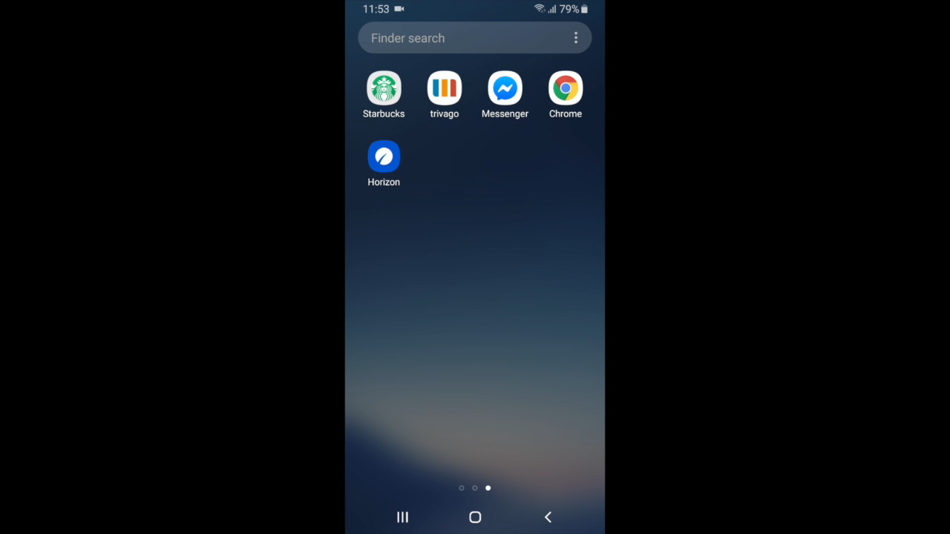
Install process
Quick access
Custom install prompt
Background and fast install
App icon
Splash screen
Synchronized Web & App

Slide 18
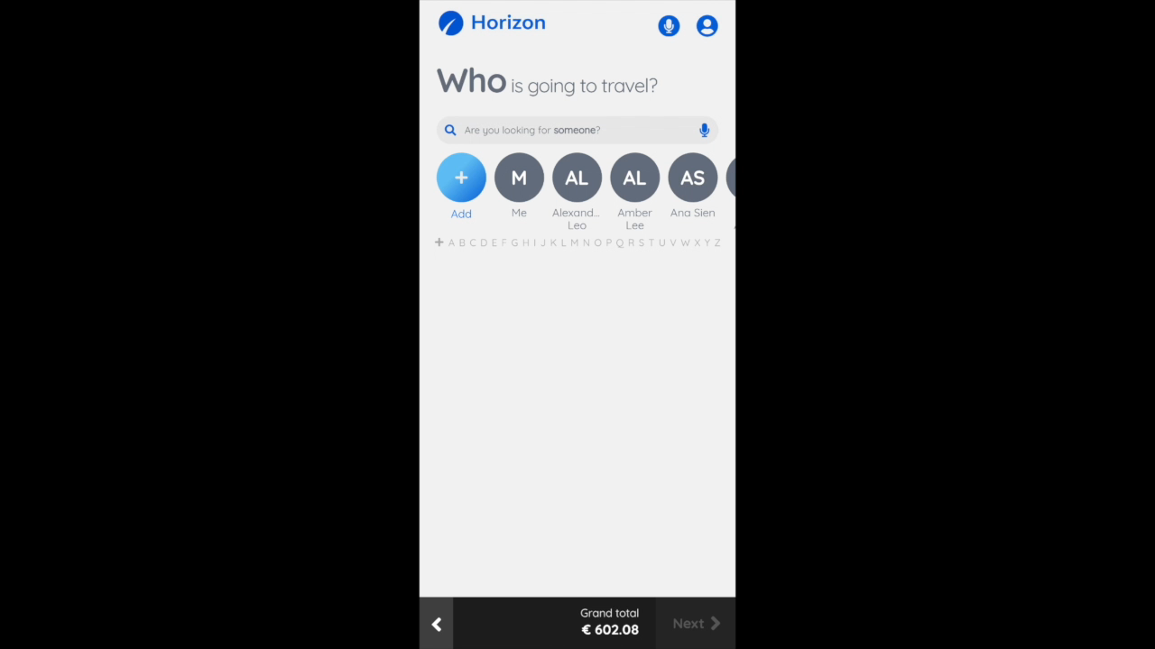
Native feel
Quick access
Custom install prompt
Background and fast install
App icon
Splash screen
Synchronized Web & App
Own window

Slide 19
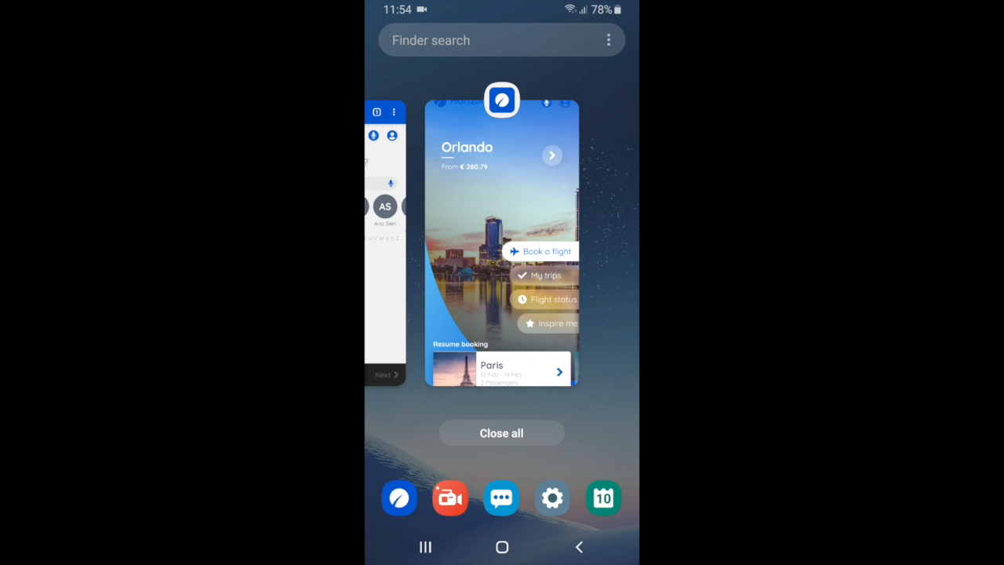
Native feel
Quick access
Custom install prompt
Background and fast install
App icon
Splash screen
Synchronized Web & App
Own window

Slide 20

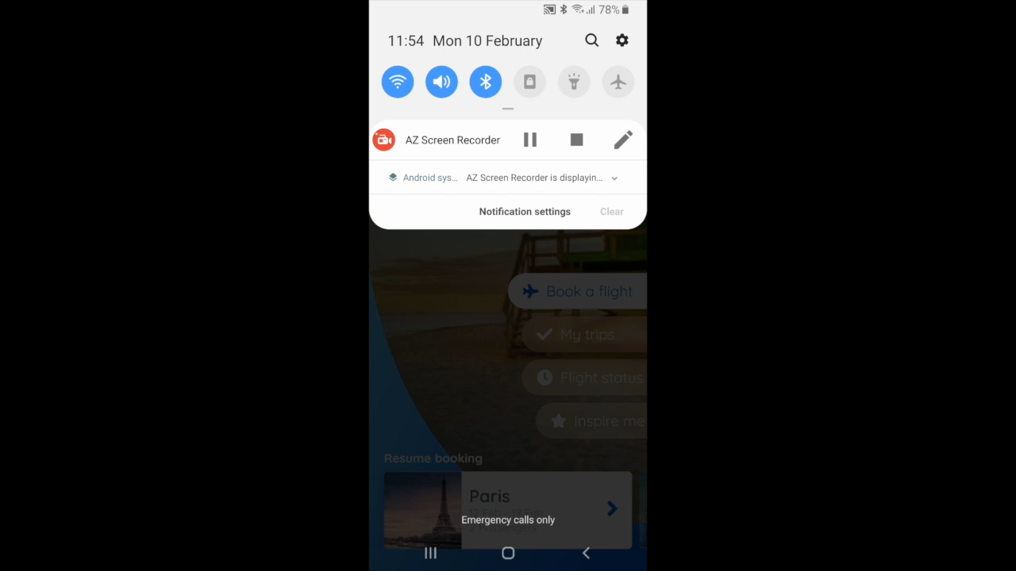
Native feel
Quick access
Custom install prompt
Background and fast install
App icon
Splash screen
Synchronized Web & App
Own window
Offline support

Slide 21
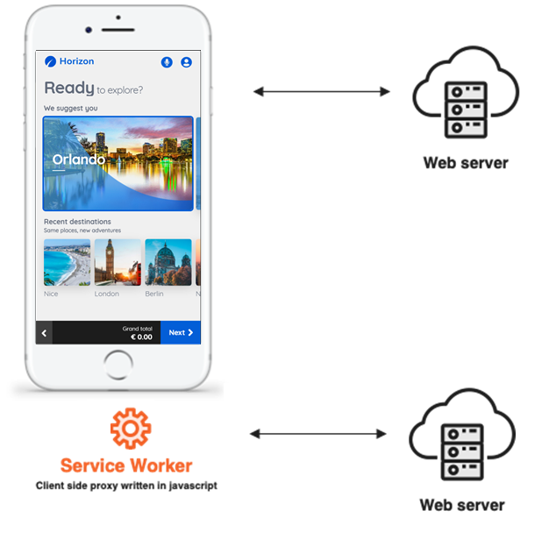

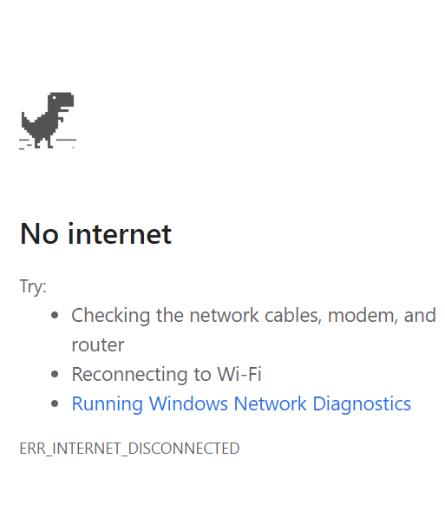
How does it work ?
Online and offline management
Browser
cache
Application v1
Application v2
Notes:
With a traditional web app, the browser gets everything from the server.
When there is no connectivity, as soon as you interact you get the dinosaur
PWA are different, there is a process called a service worker that can cache any data from the server.

Slide 22
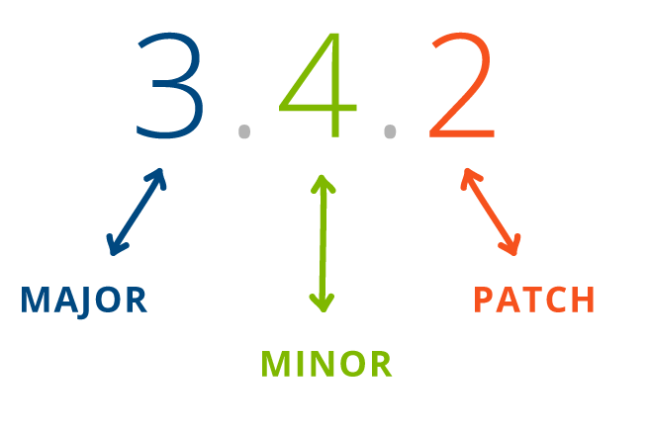
Software and content updates
Full application semantic versioning = DxAPI + ACH + RefX
DxAPI
Ex : 2.15.0
ACH
Major : Ex : ACH API version
Minor : Ex : New content key
Patch : Ex : Content update (asset, label, …)
RefX
Major : Breaking change (new DxAPI version) –> Mandatory upgrade
Minor : Change in the flow that requires customer consent –> Upgrade is up to customer
Patch : Bug fix or content update –> Silent upgrade
Notes:
Semantic versioning

Slide 23
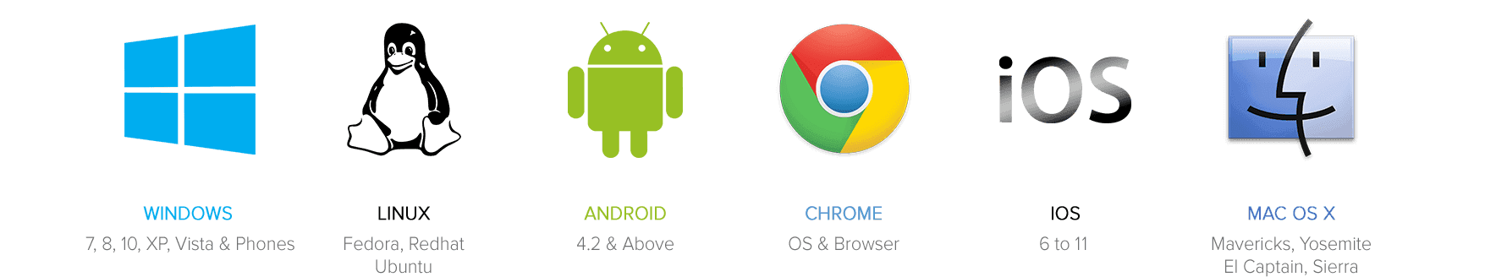

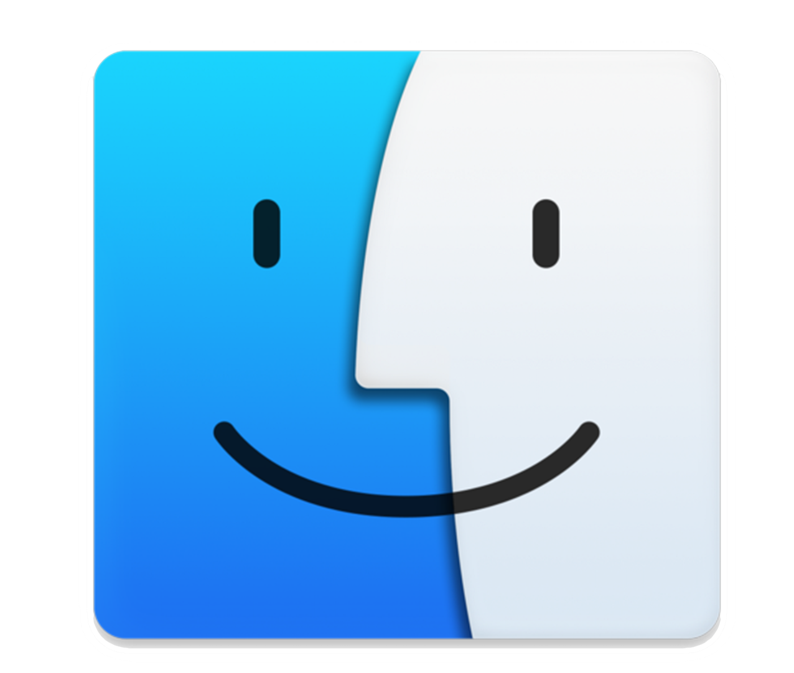
Progressive Web App support
Android
Chrome
iOS
Chrome/Safari
Windows
Chrome/Edge/Firefox
MacOS
Chrome/Safari
Cache capability
Push notification
Offline browsing
Background sync
Add to home screen
Application launch screen

Slide 24
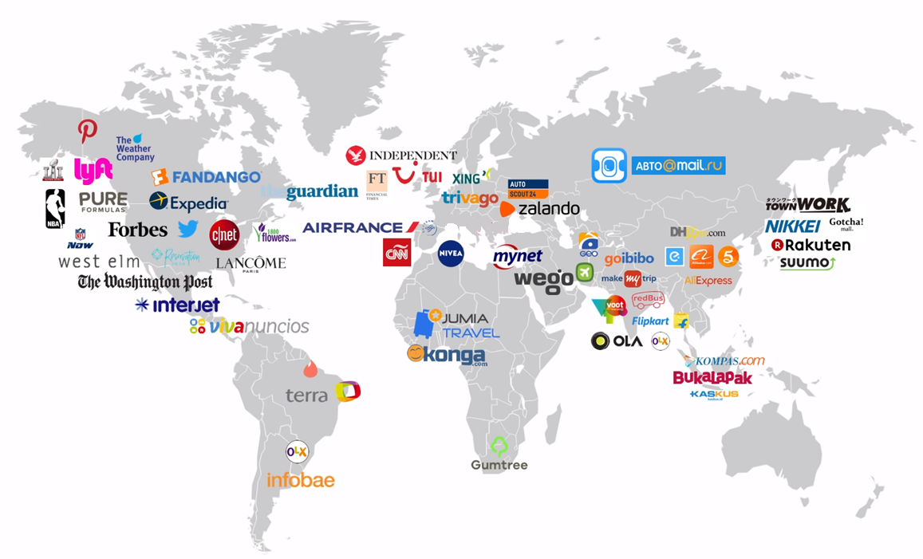

PWA in the world
Reference Experience
Notes:
So as you can see, PWA is booming worldwide and Amadeus is part of this move with Reference experience
Native Apps and PWA are still going to coexist for few years and we definitely need to adopt PWA technology as the traditional web will disappear progressively

Slide 25
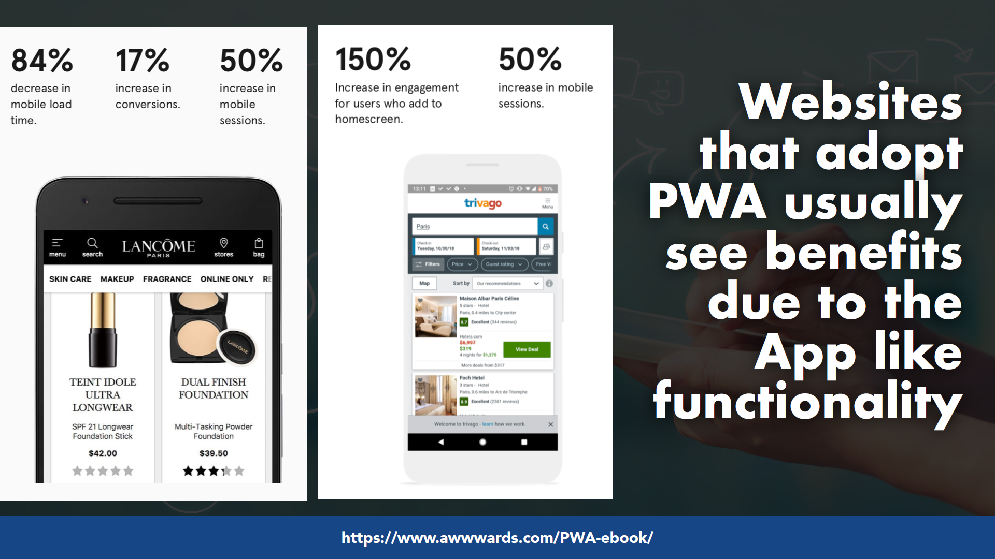
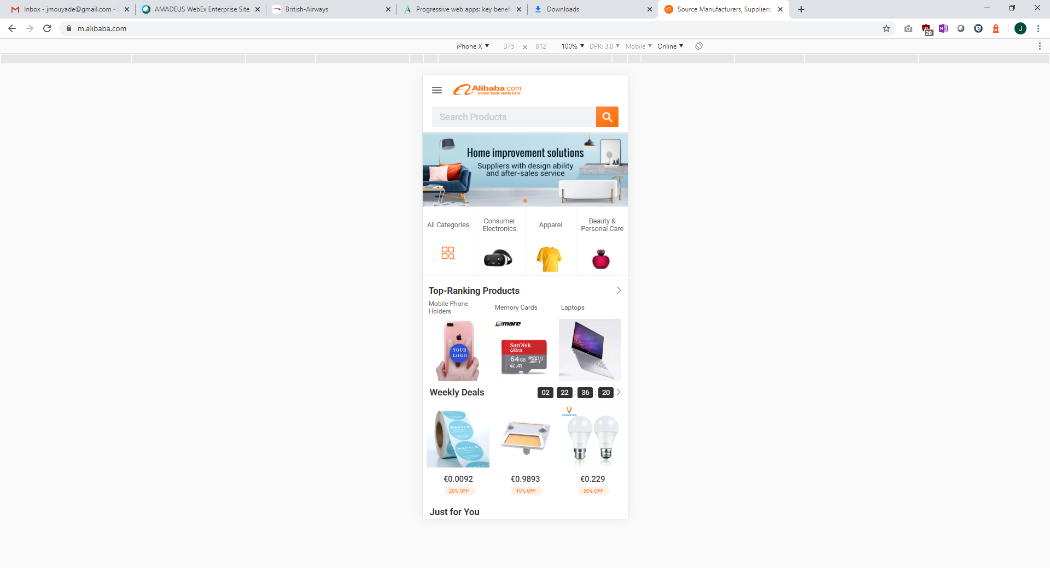
76%
Increase in conversion
30%
More active users on Android
14%
More active users on iOS
150%
increase in engagement for users who add to home screen
50%
increase in mobile sessions
Notes:
When the implemented PWA, Trivago the german aggregator noticed much more engagements from customers
And when Alibaba, the Chinese retailer, they noticed a boost and sales and much more active users

Slide 26
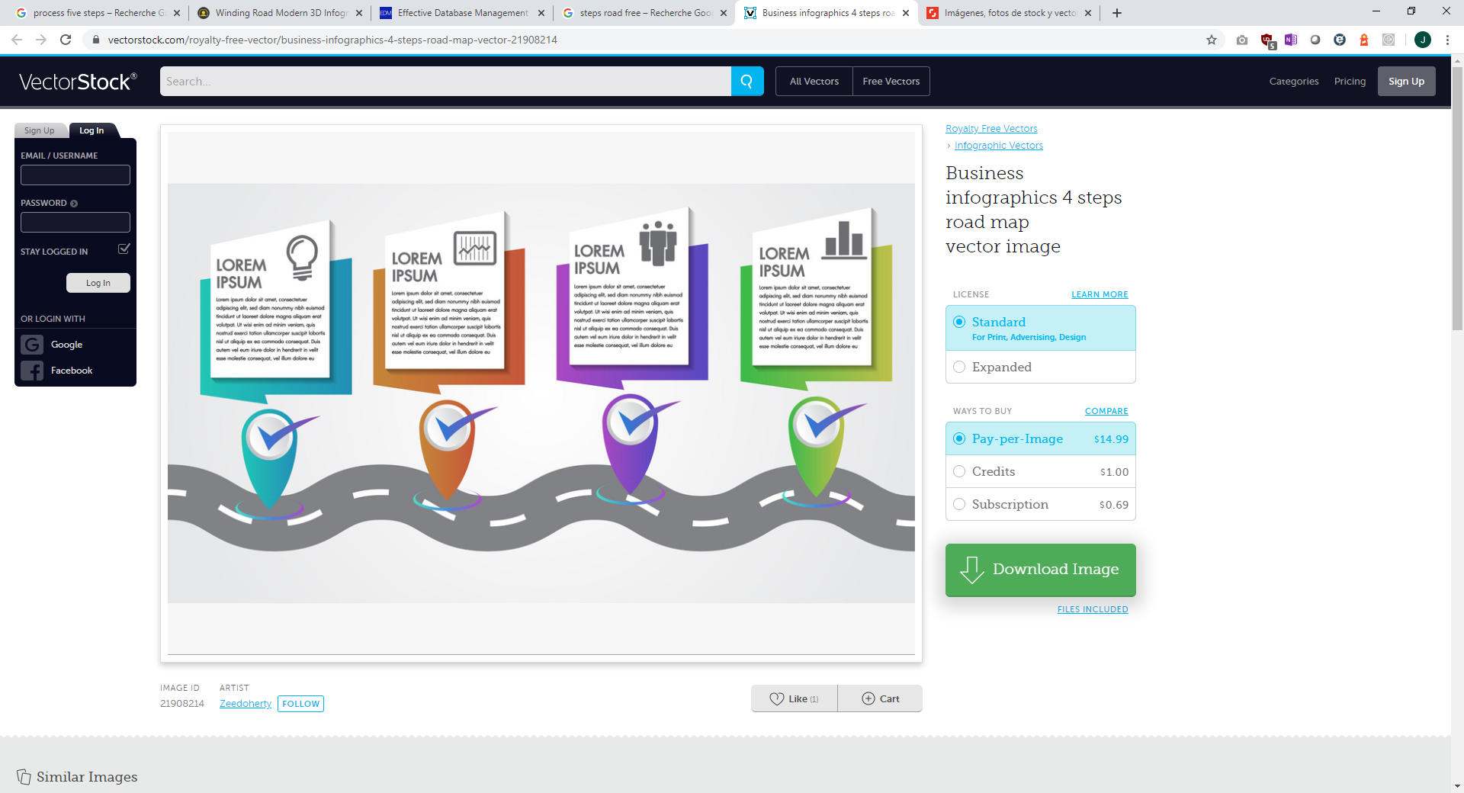






Love it ! What should I do ?
PWA : What are next steps ?
Launch Icon
File caching
Offline support
Notifications
Create icons
Create splash screens
Add manifest file
Effort :
List assets
Add service worker
Effort :
List offline pages
Add to manifest
Manage fallback
Effort :
Select provider
Identify notifications
Add handler
Effort :
Notes:
What is good with PWA is that you can go step by step :
The first step is to create a launch icon and splash screen so you are present on your customer home screen
The second step is to cache you application content to deliver a fast application to customers
Then you can implement the offline support. You have to identify the list of pages that should be available offline
Then add push notifications. Select a provider, identify your use case and you’re good to go !
Hope you found this interesting.

Slide 27
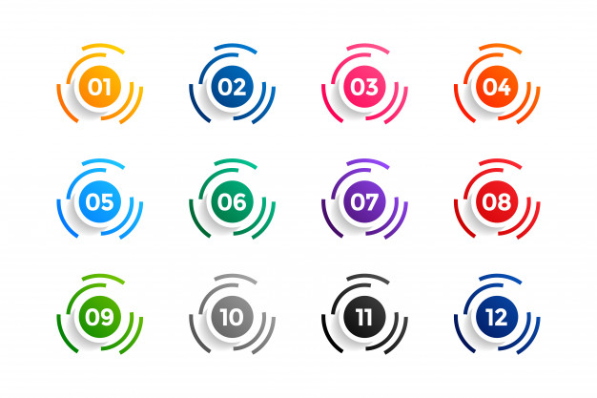
PWA : Key takeways
Better, faster, stronger mobile web
Your app is always up to date
Offline support
Progressive : step by step
Notes:
When the implemented PWA, Trivago the german aggregator noticed much more engagements from customers
And when Alibaba, the Chinese retailer, they noticed a boost and sales and much more active users

Slide 28

Thank you !
Amadeus Digital Forum 2020
Notes:
Insert new photo: Click on Insert photo-icon on slide and Insert new photo
Use Crop Tool under Picture Tools to pan and zoom
Beware: when you add or replace a picture, it may come to the front. Right click on it and select ‘Send to back’ to re-arrange it.
To update the text, just click on the text
To get more slides with this layout just copy this slide and paste
Please insert the other company’s logo in the same size as the Amadeus logo, with no background and reverse out colour

Slide 29
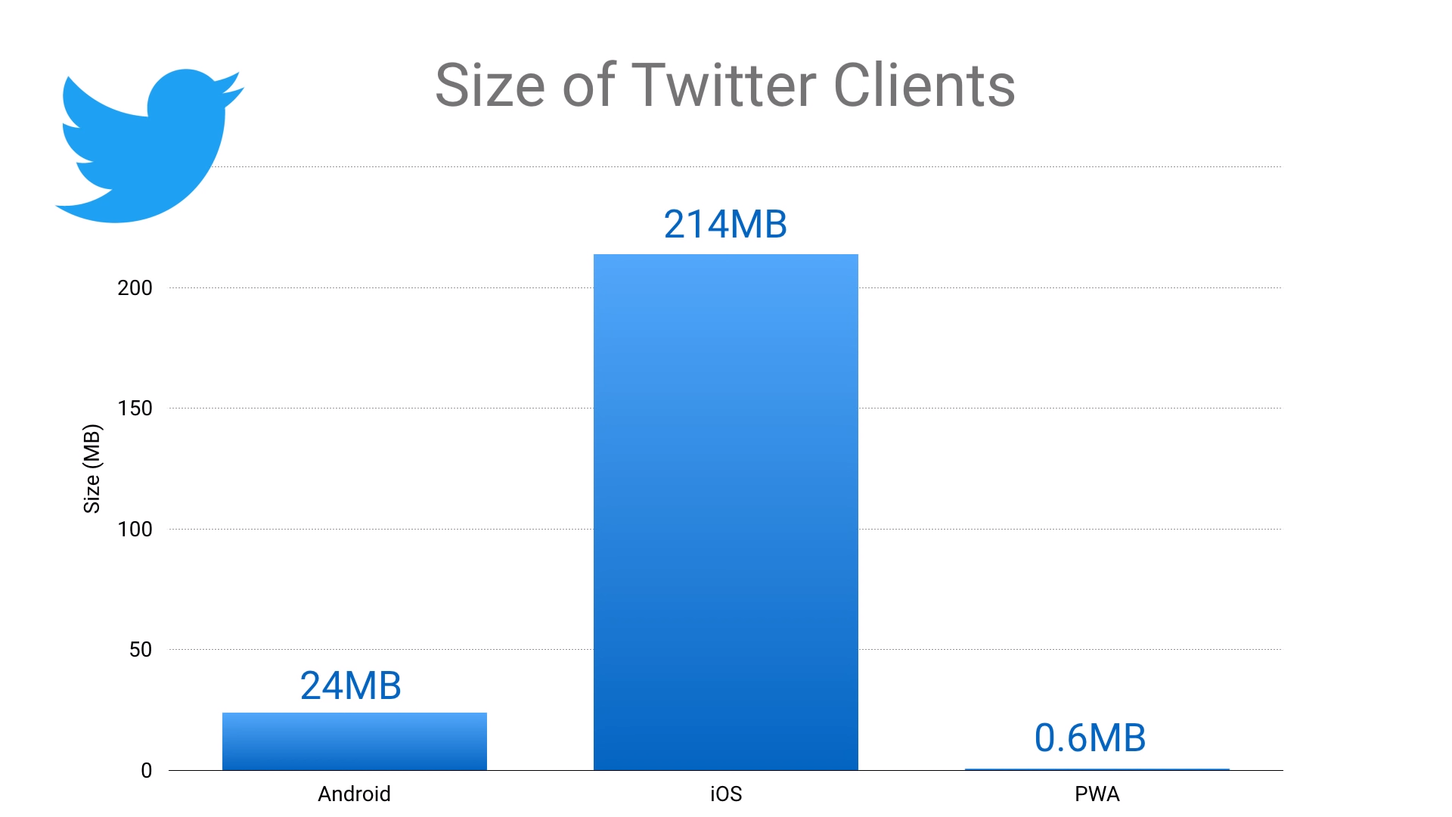
Memory consumption

Slide 30
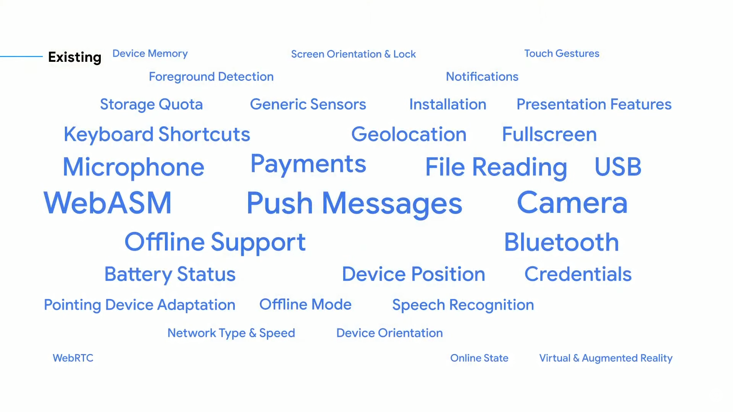
Progressive Web Application to the rescue

